Slide 1
Secure Cloud Manufacturing
Machine Process

Slide 2
Parts and process numbers
Process # | Part 1 - Chassis | Part 2 - Cabin | Part 3 - Trunk
0 | Raw material | Raw material | Raw material
1 | Machined top (CNC1 – Vacuum) | Machined bottom (CNC2 – Mechanical) | Machined bottom (CNC2 – Mechanical)
2 | N/A | Inspected | Inspected
3 | N/A | Flipped | Flipped
4 | N/A | Machined top (CNC3) | Machined top (CNC4)
5 | Inspected (finished) | Inspected (finished) | Inspected (finished)

Slide 3
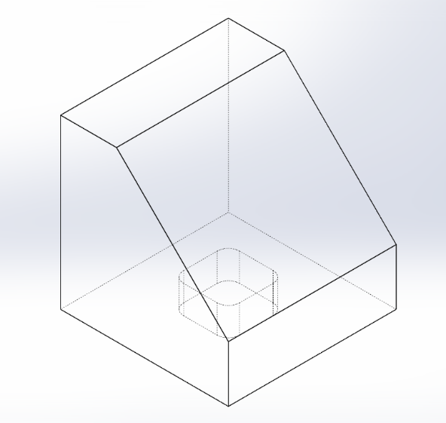
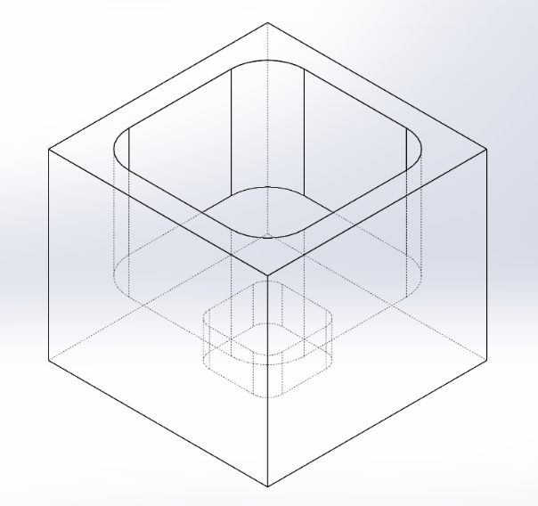
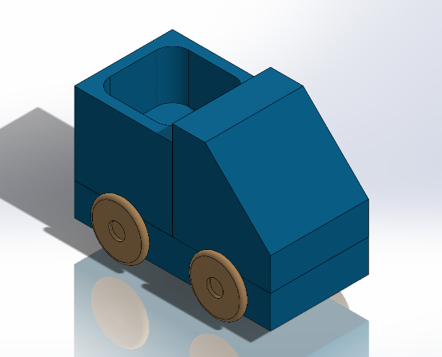
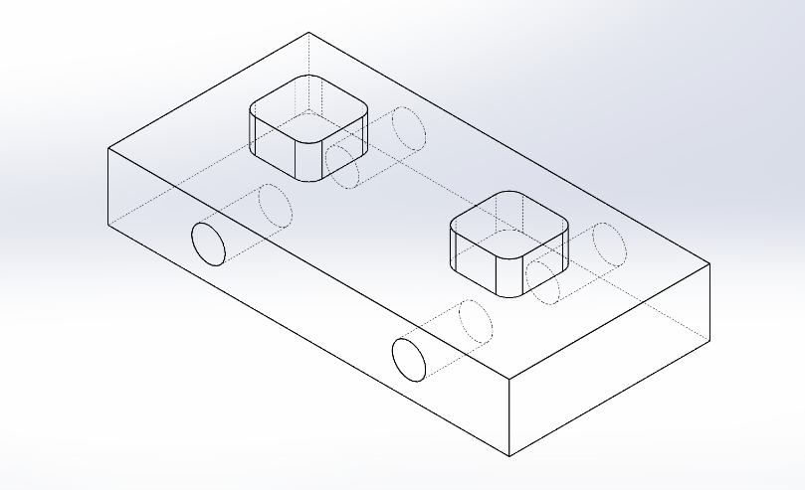
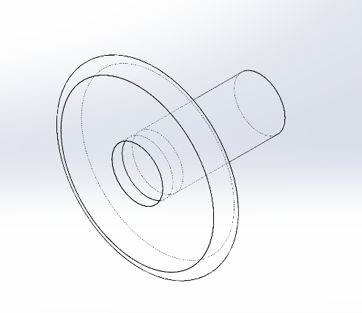
Parts CAD design
Cabin Top: CNC 3 Bottom: CNC 3
Trunk Top: CNC 4 Bottom: CNC 4
Chassis Top: CNC 1 Bottom: CNC 2
Wheel

Slide 4
Parts Process Arrangement
Chassis Part 1
Process 1 Top surface face milling 18min with CNC1
-- Depth: 0.2”
-- Tool: 1/4” end mill
-- Gripper: vacuum gripper
Post processing Wheel Holes Drilling 4 x 2min (manually)
-- Depth: 4 x 0.5”
-- Tool: 1/4” drill
3.0’’
20’’

Slide 5
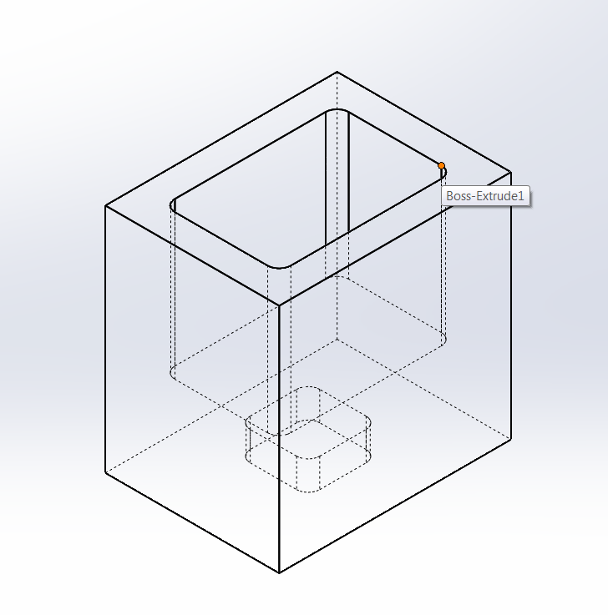
Parts Process Arrangement
Trunk Part B
Process 1 Bottom surface face milling 20min with CNC2
-- Depth: ? ? passes
-- Tool: ?
-- Gripper: mechanical gripper
Process 2 Top surface face milling and pocketing
in with CNC4
-- Depth: 12mm
-- Tool: 5/16” end mill
-- Gripper: mechanical gripper
2.0’’
2.0’’
1.5’’

Slide 6
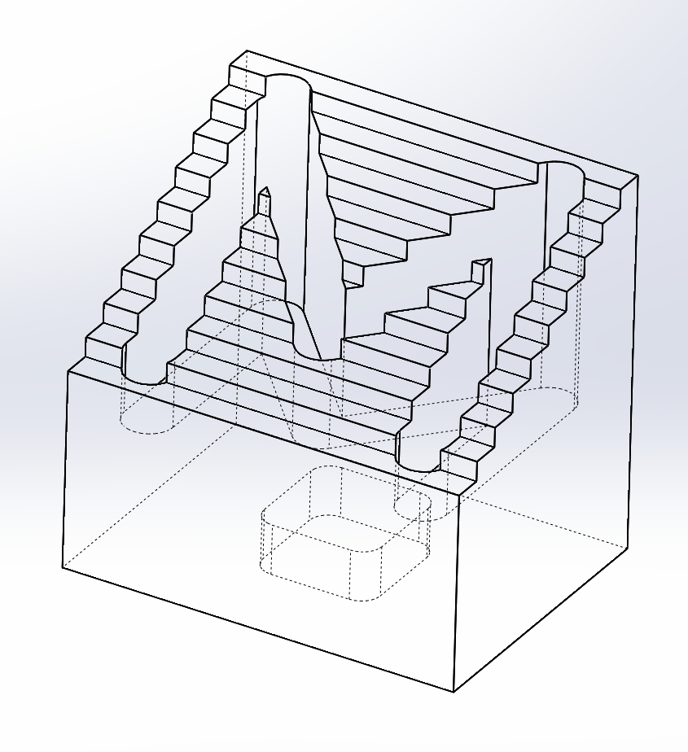
Parts Process Arrangement
Cabin Part C
Process 1 Bottom surface face milling and pocketing
25min with CNC2
-- Depth: ? ? passes
-- Tool: ?
-- Gripper: Mechanical gripper
Process 2 Top surface stepped face milling ?min with CNC3
-- Depth: ? ? passes
-- Tool: ?
-- Gripper: Mechanical gripper
2.0’’
1.5’’
2.0’’

Slide 7
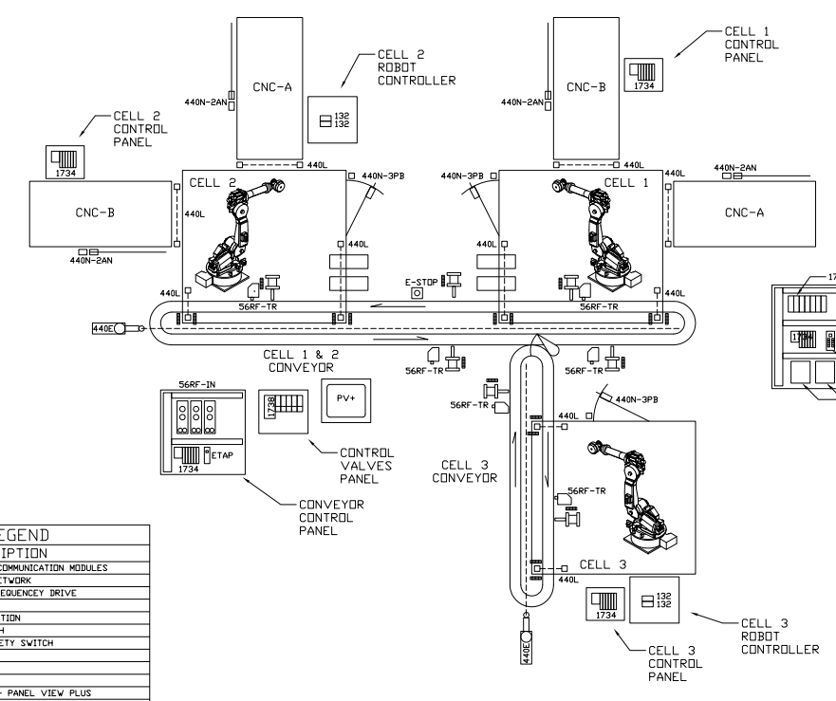
Parts Process Arrangement
Demonstrate relative process priority
Robot manipulation time ignored
Data based on experiment April.2016
Time not to scale
3
2
4
1
#2 1min
#1 5min
1
#4 2min
#3
15min
2
#5 12min
3
#6 4min
4
Time

